Slide 1
Exercise Support - Short Term Operational Contractors (STOC 2.0) Bidder’s Information Presentation IFIB-ACT-JWC-23-49
Date: 24 June 2024
Contracting Officer: Mr. Raymond Darnell (A2- GBR)
STOC COTR: CDR Stephan A Lubosch (OF-4 USA-N)
24 Jun 2024

Slide 2
Agenda
Introduction
Plan of Action and Milestones (PO&AM)
Overview of JWC
STOC Requirement
NATO Exercise Expectations
Main Exercise Blocks
EXCON Structure (Standard)
Bid Packages
Award Criteria
Administrative Envelope
Technical Envelope
Technical Review Process
Pricing Envelope
Clarification Process
Wrap Up/Closing Remarks

Slide 3
Introduction
The purpose of this presentation is to provide potential interested bidders with a general overview of NATO’s Joint Warfare Centre (JWC), the requirement and the procurement process for this specific requirement.
As a reminder all bidding documents including any amendments and/or clarifications can be found under the “Procurement” tab at https://www.jwc.nato.int/index.php/organization/contracting#Procurements
If you can not access a document/Annex or require it in a different format then please email PCS@jwc.nato.int cc’ing Raymond.Darnell@jwc.nato.int and we will arrange for it to be emailed to you.

Slide 4
Plan of Action and Milestones (POAM)
Summary Timetable | Date | Comments
Solicitation Release | 4th June 2024
Last date that bidder’s may request clarifications | 16th July 2024 | Bidders are advised to check the JWC webpage on a regular basis for possible updates and clarifications.
Deadline for Submission of the Bids | 13th Aug 2024 | Tenders delivered by received via email by 13:00 CET.
Contract Award Committee Opening Session | 19th Aug 24 | Estimated
Evaluation Period | 20th Aug - 14th October | Estimated
CAC Award Meeting | 20th October 2024 | Estimated
Contract Implementation Period | 22nd October – 30th November 2024 | Estimated
Contract Go Live/Start | 1st December 2024

Slide 5
Overview of JWC
Established in 2003 and reached full operational capability in 2006.
Based in Stavanger, Norway
Subordinate HQ under HQ SACT
Has a workforce of over 250 (Military & Civilian) representing 17 NATO member nations.
JWC is NATO’s training focal point for full-spectrum joint operational and strategic level warfare providing NATO’s Computer-Assisted Command Post Exercises (CAX/CPX) at the operational and strategic levels, for both non-Article 5 Crisis Response Operations and Article 5 Collective Defence.

Slide 6
STOC Requirement
The 360-degree Exercise Environment with its embedded exercise-generic settings and exercise-specific scenarios enables the delivery of high value exercises to NATO Command Structure and Force Structure entities and organizations .
Directed by Allied Command Transformation (ACT) as well as SACEUR’s Annual Guidance for Exercises (SAGE) and the Military Training Evaluation Plan (MTEP).
JWC is seeking to integrate contracted expert service support to respond to the continual increase with regards to scale, scope and complexity of the 360° exercise environment – requirement of 24/7 operations for selected exercises.
Achieved through a combination of Military/NATO staff and this service’s provision of expertise operating in a collaborative production environment.

Slide 7
STOC Requirement- Continued
STOC stands for Short Terms Operational Contractor.
When it is not possible to fill a position from military sources, the JWC has the option to source a contractor to fill a position. Not all contracted positions are required for each phase of each exercise.
STOC contribute to JWC mission and outputs through utilization of their subject matter expertise.
STOC’s are typically engaged only for a few weeks at a time in line with the exercise planning process
SOW Annex A contains the task functions and technical criteria for the Exercise Play Functions.
The vast majority of work will be conducted onsite at JWC.
There will be some opportunity for remote work but this is at the discretion of the JWC authorized requestor based on security requirements and the requirement for in person collaboration.

Slide 8
Unfortunately due to the security classification we are unable to provide a timeline of events from JWC’s Programme of Work (POW) where we anticipate STOC will be utilized during the tender/bid phase.
However, once on Contract we will actively engage with the winning Supplier(s) to allow forward planning of resources and allow you to de-conflict events/projects with your STOC Candidates.
JWC has established processes in place which can support winning Suppliers with process of obtaining D Numbers for STOC Candidates. (Norwegian Social Security Numbers / National Insurance Number equivalents if these are not already in place.)
For Bidders unfamiliar with working with JWC you may wish to read through the Supplementary Agreement between the Kingdom of Norway and the HQSACT and SHAPE as certain provisions cover Contractors, document is available here;
https://lovdata.no/dokument/TRAKTATEN/traktat/2008-08-06-21/KAPITTEL_1#KAPITTEL_1

Slide 9
NATO Exercise Program - Expectations
4 Exercises per year
At least 1 Exercise every 4 years to be conducted with a 24/7 Battle Rhythm.
Given the dynamic environment NATO operate in, this may be subject to change at short notice.
In terms of the number of days each roles will be used, this will vary depending on the stage of the Exercise (Planning vs Execution) and if NATO Nations are able to provide suitable personnel to fulfil the play functions.
STOC's can only be utilized if NATO Nations do not have available personnel.
Typically STOC's will be engaged for a period of between 5-15 days for Development/Planning Workshops and during Exercise Execution Phase.

Slide 10
Main Exercise Blocks (ref JWC SOI 800)
Stage 0 and 1 - Exercise Initiation and Specification (EDA – ESC) – Key Factors: EXSPEC, support requirements.
Stage 2 – Exercise Planning and Product Development – Key Factors: CPT, CIS/IERs, IM, TOs, OCE EPG, EXPLAN, Scenario Modules, MEL-MIL, OPFOR, CAX, CPTMs, IPC, MPC, FCC.
Stage 3 – Conduct – Key Factors: MEL-MIL, OPFOR, EXCON (design, C2 and staffing), priorities.
Training Blocks A and B - Individual and Collective Training including BST
Training Block C - Crisis Response Planning
Training Block D/E – Execution
Strategic Workshop – 5 Days
Incident Development Workshop (IDWS) – 5 Days
Scripting Workshop (ScWS) - 12 Days
Employex (EXCON Training + Exercise Execution) – 10 + 5 Day (15 Days)
Exercise Feedback Process – Assessment, Analysis and Reporting.
Requirement for STOC Support

Slide 11
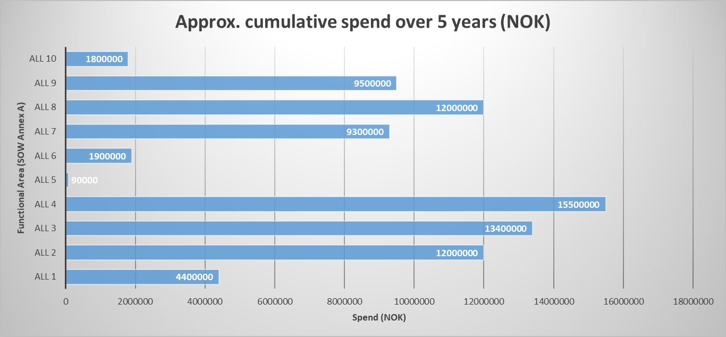
Functional Area 10 roles have been assessed and incorporate into relevant functional areas for re-tendering so there is no Area 10 in current SOW Annex A.

Slide 12
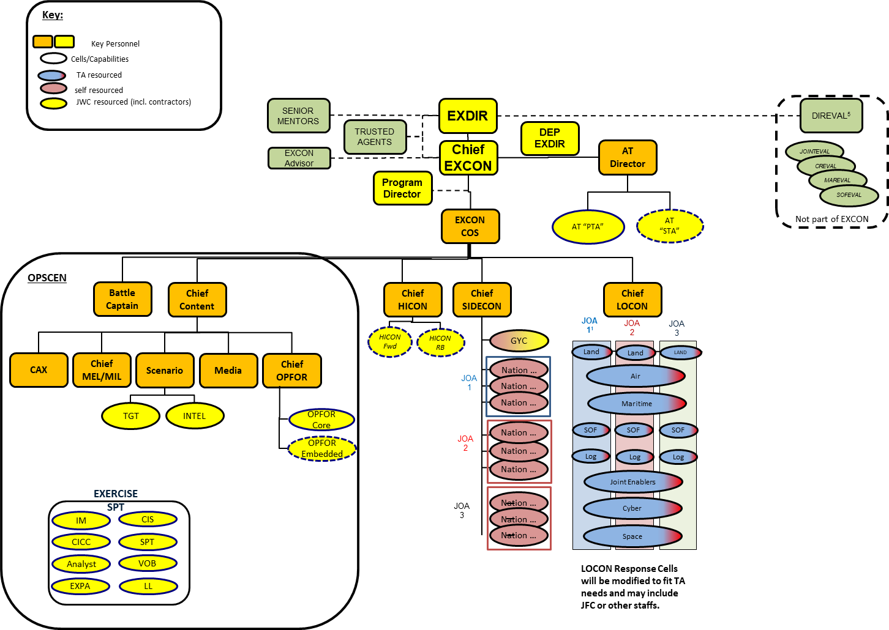
EXCON Set Up
STOC Support

Slide 13
Bid Packages
Admin (Envelope A)
Technical (Envelop B)
Price (Envelope C)
Bid Submission Form (Annex A-0)
Compliance Statement (Annex A-1)
Certificate: Legal Name of Bidder (Annex A-2)
Certificate: Independent Determination (Annex A-3)
Certificate: Bid Validity (Annex A-4)
Certificate: Exclusion of Taxes and Charges (Annex A-5)
Certificate: Authorization to Perform (Annex A-6)
Technical Criteria & Evaluation Form
Annex B-1 Quality Assurance & Customer Service Methodology Evaluation
Annex B-2 – Proposed Candidates Resumes and completed Technical Evaluation Matrix
Annex B-2a – EPF Candidate List Summary Sheet
Annex B-3 – Past Performance Worksheet
Annex C-1 – Pricing Worksheet

Slide 14
Award Criteria
Administrative
Annex A 0-6
Compliant – Pass/Fail
Designed to ensure compliance with T&C, business is eligible for NATO Contracts.
Technical
Requires submission of bidder compiled statement of customer quality and ability to deliver service.
Requires completion of technical matrix and submission of CV & Security Clearance.
Commercial
Annex C-1
Price in NOK only
All Pricing Ex VAT/MVA
Value Rate calculated using the formula in the solicitation documents to create Master Priority List (MPL).
Lowest Cost Technically Compliant (LCTC)
Eligible for Contract Award, subject to CAC Approval and Funding Confirmation
ID/IQ Contracts with a ROM of 100-130M NOK over 5 years.

Slide 15
Administrative Envelope
Bidders are required to complete the all Administrative Annex’s, sign and submit as PDF’s when ready to submit bid.
Administrative Proposal should be emailed to PCS@jwc.nato.int, cc’ing in Raymond.Darnell@jwc.nato.int and AnneGrethe.Bjastad@jwc.nato.int
Administrative envelope is the first hurdle and failure to complete and submit all documents is grounds for bid disqualification/dismissal.
The Administrative Annex’s confirms that the Supplier:
Is an eligible NATO member entity,
Suppliers compliance with requirement,
that pricing is free of VAT,
that the bid remains valid for a set period after submission,
that the bid is free from conclusion,
that no Supplier or sub-contractor has been debarred from working for NATO previously.

Slide 16
Remember that Partial Bidding is authorized, there are 57 Exercise Play Functions and we require a minimum submission against 10 EPF.
For Award consideration at least 5 of the 10 EPF must pass technical evaluation and achieve a value rate position of #1,2 or 3 based on pricing evaluation.
Carefully read the security clearance requirements for candidates and remember to attach proof of candidate clearance to CV/Resumes.
NATO SECRET security clearance or national level equivalent is required.
We are allowing candidates with a valid clearance to be submitted if proof of an active clearance can be shown in the last 18 months.
Task Order requires an active NATO SECRET clearance not later than 35 days prior to task commencing.

Slide 17
Technical Envelope
Technical Proposal should be emailed to TechnicalProposal@jwc.nato.int , cc’ing in Raymond.Darnell@jwc.nato.int and AnneGrethe.Bjastad@jwc.nato.int
Technical evaluation involves the following;
Annex B-1 – Supplied complied, relating to Bidder’s quality assurance & customer service methodology, max 5 sides of A4 - Font Arial or Times New Roman, size 12.
Annex B-2 – This is the Supplier completed technical matrices with supportive narrative and CV/Resumes for proposed Candidates.
Annex B-2a – Complete the summary of candidates Excel spreadsheet
Annex B-3 Past Performance Information – Complete and Submit the past performance information

Slide 18
Technical Review Process
EPF is split into 9 Support Areas
EXCON
HICON
OPFOR
INTEL
MEDIA
TARGETING
GENERAL SUPPORT (GENDER, SOCIA, UN)
HOST NATION CIVIL
HOST NATION MILITARY
Individuals’ résumés will be measured against each of the criteria specified in the matrix.

Slide 19
The same candidate can be nominated for more than 1 EPF if you believe they meet the criteria of each additional EPF.
Avoid generic phases like see Resume/CV attached. In the narrative be specific as the skills or experience and where in the CV/Resume to find further details to assist evaluators.

Slide 20
Pricing Envelope
Pricing Proposal should be emailed to PricingProposal@jwc.nato.int only.
Pricing must be in NOK only and be free of VAT/MVA
The pricing will be assessed in line with formula specified in the solicitation package. This will establish a value rate for evaluation purposes.
WU rates should be fully loaded, meaning inclusive of all overheads, expenses and profit.
Master Priority List (MPL) will be generated based on the value rate for base year and each option year, the #1 Contractor for that Play Function Area will get 1st opportunity to confirm STOC availability for task order.
ROM over 5 years is 100-130M NOK. However, due to how NATO is funded this can not be guaranteed and is provided only as a guide based on historic spend and potential future Exercise schedule.

Slide 21
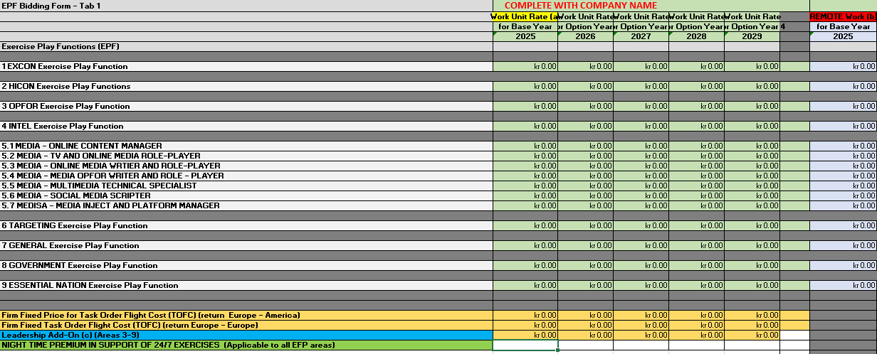
EPF link to SOW A – All function apart from Functions in Area 5 will have a single WU and Remote WU Rate. Functional Area 5 the roles have been split out.

Slide 22
Travel costs will work on a fixed price basis, Bidders are required to provide a fixed cost for a return flight Europe- Europe and North America (USA/Canada) – Europe
Bidder are required to provide a fixed cost for the Leadership Add-On, the definition of Leadership Add-On can be found in the SOW.
For Night-Time premium, Bidders are required to input a % amount that would be applicable for night time working on those Exercise that require 24/7 Support, the exact time period may vary according to each Exercise Battle Rhythm.
1 WU is the equivalent of a 12 hour days, 0.5 WU is equivalent of up to 6 hours work. This is not to say everyday a STOC is deployed they will be working 13 hours days this is just to capture the maximum that may occur depending on the Exercise Phase. For example if the days activates concluded after 7.5 hours, the Supplier is still entitled to invoice 1 WU.

Slide 23
Clarification Process
All bidders are free to ask clarification questions about any aspect of the solicitation package.
Clarification questions should be submitted to PCS@jwc.nato.int, cc’ing Raymond.Darnell@jwc.nato.int and AnneGrethe.Bjastad@jwc.nato.int
They will then be distributed to the subject matter expert within JWC for a response.
Clarification questions will be anonymized and answers published on our website to allow all bidders to see the response, the website address is as follow; https://www.jwc.nato.int/index.php/organization/contracting#Procurements
It is the bidders sole responsibility to check this site regularly to keep abreast of updates and responses.

Slide 24
Wrap Up
Key points
Read through the solicitation package fully
Make sure you can access/download all document and Annex. See Annex A-0 for full list.
Don’t make assumption, if in doubt seek/ask for clarification.
Be mindful of the deadline, both clarification question deadline and bid submission deadline.
Ensure you have sufficient time to email in your bid submission, be mindful of attachment size limits and if in doubt divide and number your emails as detailed in the Solicitation package.
Check https://www.jwc.nato.int/index.php/organization/contracting#Procurements regularly for updates.

Slide 25
Thank you

